Slide 1



“Attendance and Leave Management”
Submitted by: Parth Deshmukh, Shekar HM, Aishwarya Tembhurne
Project Type: Group Project
Group No. : 5
Batch No. : 12
Program : Axis Fintech Program
Date: 14/07/2023
Git Link: https://github.com/aishwaryatembhurne/Attendance-and-Leave-Management-Group-5

Slide 2

Table of contents
Introduction
Project Overview
Architecture Design
Back-end Development
Front-end Development
Conclusion
Future Work
References

Slide 3
Introduction
Attendance and Leave Management System is a Centralized platform for efficient attendance management and leave tracking
Simplifies processes for employees and HR representatives
Modern technology to streamline operations and improve productivity

Slide 4

Project Overview
Functionalities
Employee:
Mark attendance as Work from Home (WFH) or Work from Office (WFO) based on assigned roster
Mark attendance for single or multiple consecutive days
Receive reminder alert email for missed attendance
Apply for leave and view leave balance simultaneously
Receive notification email for approved or rejected leave applications
View personal details in profile

Slide 5
Project Overview
Admin:
Upload roster for hybrid employees (WFO and WFH days)
Add new employees to the organization (form or Excel upload)
Manage leave applications submitted by employees
Access month-wise reports on total present and absent employees
Generate attendance reports for individual employees
Access reports displaying employee-reporting manager mapping
Generate reports on attendance of managers' reportees
Download reports in Excel, and PDF format

Slide 6
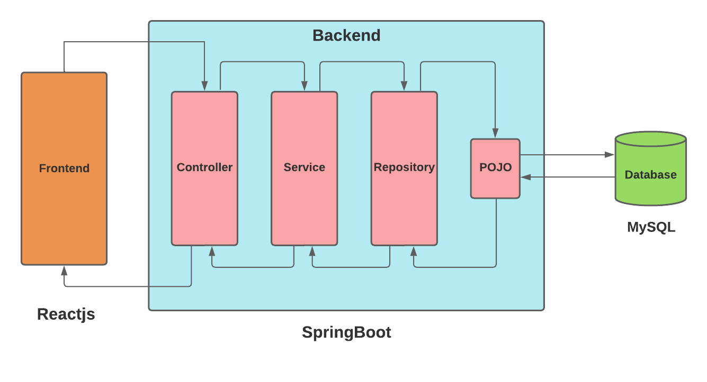
Architecture Design

Slide 7



Back-end Development
Technologies :
Spring Boot: Spring Boot is a Java framework that simplifies the development of stand-alone, production-grade Spring applications.
Spring Security: Spring Security is customizable, authentication and access control framework.
Postman: For testing Crud operations.
Database: MySQL database.
Dependencies :
Spring Devtools
Spring web
Spring Security
MySQL Driver
Lombok
JPA

Slide 8



Front-end Development
Technologies :
React.js: ReactJS: ReactJS is a popular JavaScript library used for building user interfaces. It provides a component-based approach to development.
Axios: Axios is a widely used JavaScript library for making HTTP requests in the browser.
CSS: It is simple style sheet language use to describe the presentation of the document written in jsx .

Slide 9

Conclusion
Comprehensive solution for attendance and leave management
Automates processes, enhances efficiency, and reduces errors
User-friendly interface for easy attendance marking and leave application
Intuitive HR management tools and robust reporting capabilities

Slide 10
Future Work
Implementing new feature such as Rotational Shifts.
Deploying on cloud

Slide 11

References
React:
https://react.dev/
Java:
https://docs.oracle.com/en/java/
Spring Boot:
https://spring.io/projects/spring-boot
SQL:
https://dev.mysql.com/doc/

Slide 12


